Slide 1
Ezekiel 13-15
“Son of man, prophesy against the prophets of Israel who prophesy…” (13:2)

Slide 2
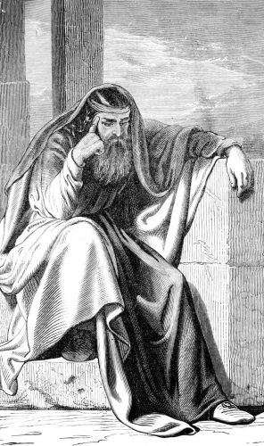
Two scathing Oracles Delivered (13:1-23)
First, The “Prophets” are Condemned (13:1-16)
Why?
Prophesy from themselves (13:2-3)
Undermined the nation (13:4)
Shown no moral courage in the “day of battle” (13:5)
They were making false claims (13:6-7)
“Therefore, thus says the Lord God…” (13:8-16)

Slide 3
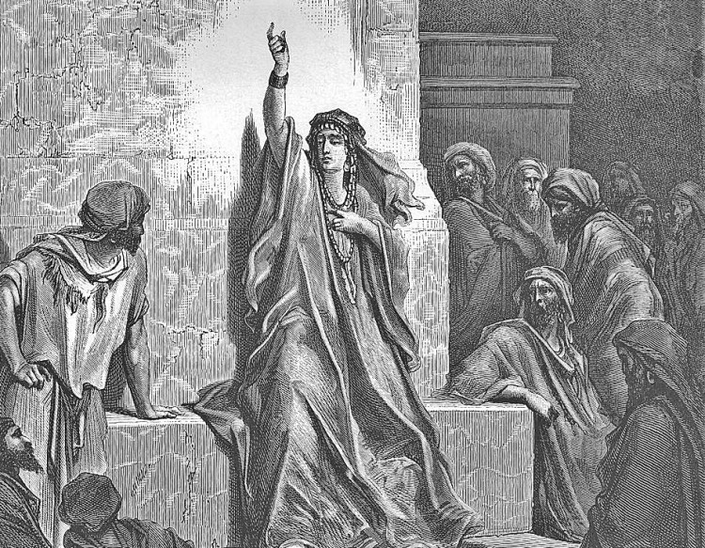
Two scathing Oracles Delivered (13:1-23)
Next, The “Prophetesses” are Condemned (13:17-23)
Why?
Prophesy from themselves (13:17)
Practiced the occult arts (13:18)
Profaned God (13:19)
Discouraged the righteous with lies (13:19, 22) Encouraged the wicked…
“Therefore, thus says the Lord God…” (13:20-23)

Slide 4
Anticipated Objections Answered (14-15)
As the elders gathered in Ezekiel’s home, God directed the prophet to answer four anticipated objections to his message of judgement…
Objection #1: Surely Ezekiel’s warnings did not apply to them (14:3-8)
Objection #2: How can you be so harsh? We were only listening to men who claimed to be prophets! (14:9-11)
Objection #3: How can God destroy the righteous along with the wicked? (14:12-23)
Objection #4: How could God forsake his covenant, the vine of His planting? (15:1-8)

